Slide 1
Streck Bridging
Roee Orland
10/03/2026

Slide 2
Background
The SomaLogic Process
A plate is read into text files comprised of RFU readings
These files undergo a series of non-linear normalization steps
Final readings are used as input to Oncohost models (PROphet)

Slide 3
Background - continued
Current Challenge
When switching collection methods RFU readings are shifted
To effectively apply our PROphet models we need to be able to translate the new (Streck-based) readings into their EDTA-based equivalents

Slide 4
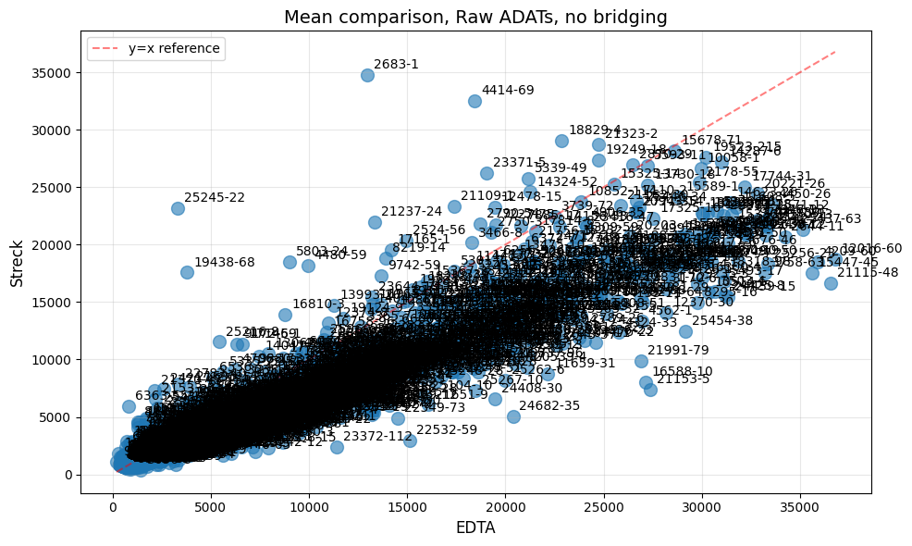

Slide 5
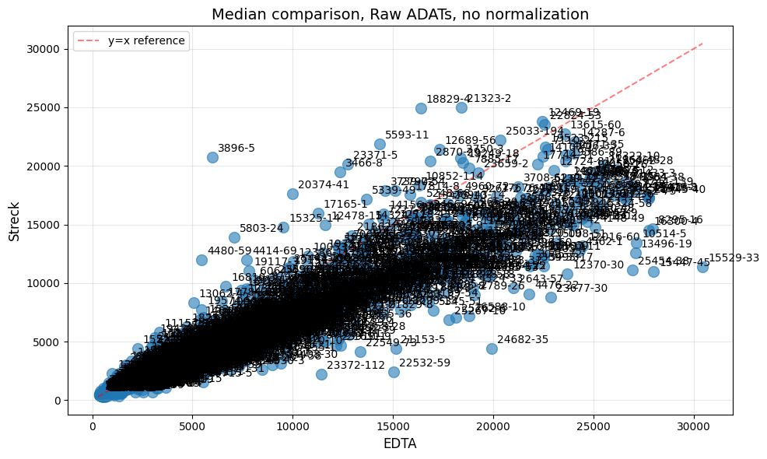

Slide 6
Background - continued
Current Solution
Linear bridging - multiplying Streck results by ratio of medians between historical EDTA and Streck values per protein
Applied post-normalization (after SL pipeline has been completed)

Slide 7
Background - continued
Issues with Current Solution
Flags – Raw Streck readings undergoing SL normalization raise flags during SL’s ANML normalization stage (last stage of SL normalization)
Strong possibility that non-linear effects of normalization steps significantly reduce signal

Slide 8
Proposed Solution
Pre-hybridization bridging
Address the effects of the new collection method before normalization effects
Physically more appropriate
Reduces possibility of method-based flags

Slide 9
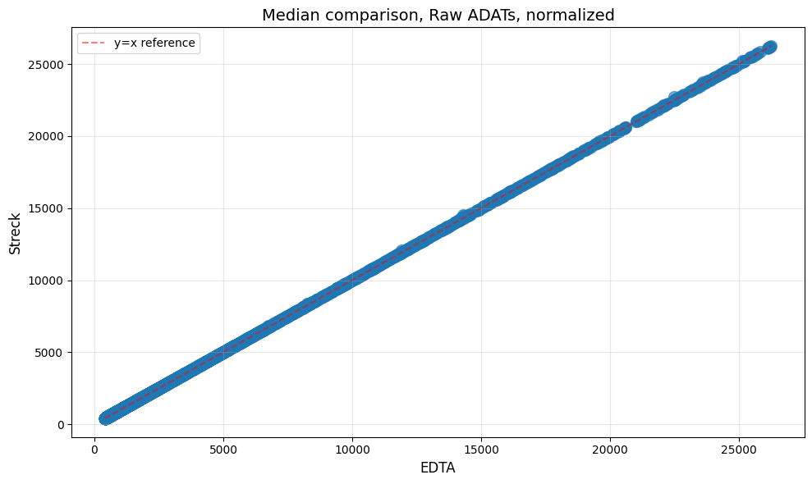
Pre-normalization results of pre-hybridization bridging
  Pre-normalization assessment

Slide 10
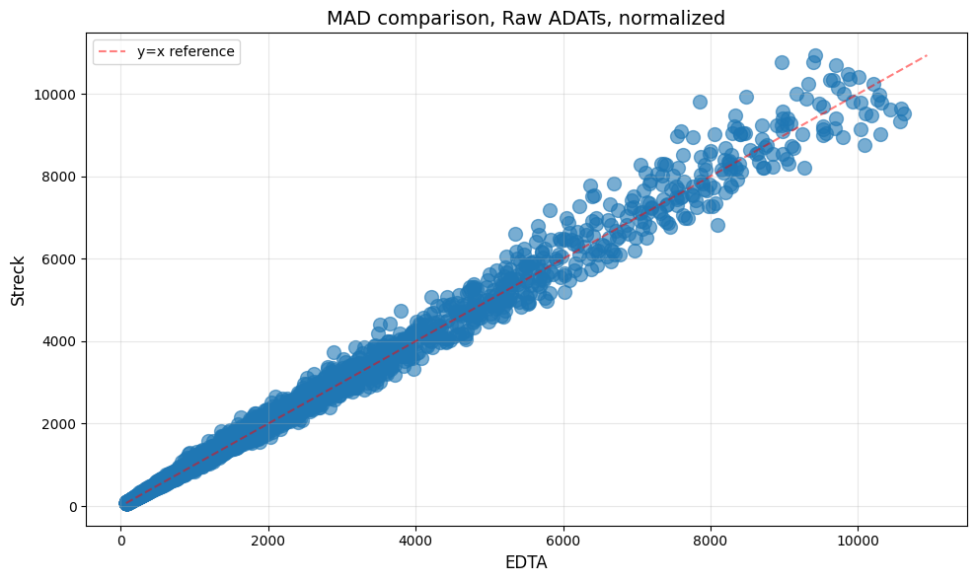
Pre-normalization results of pre-hybridization bridging - continued

Slide 11
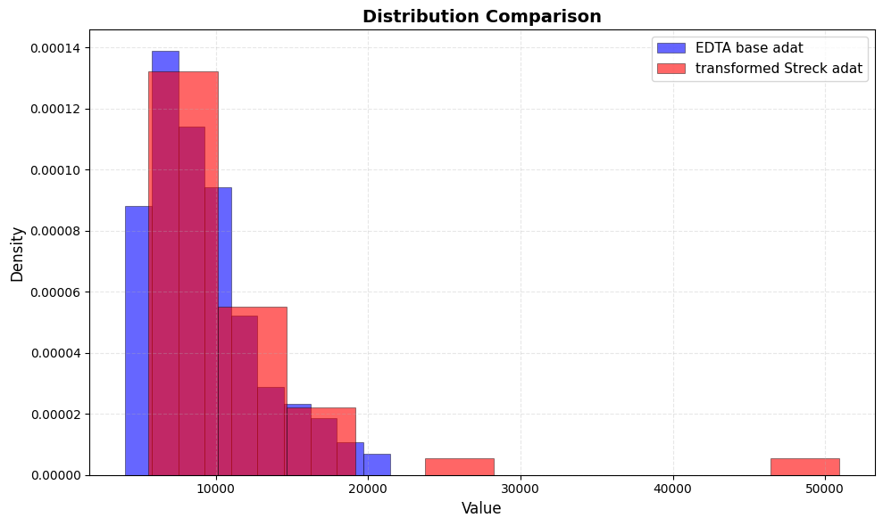

Slide 13
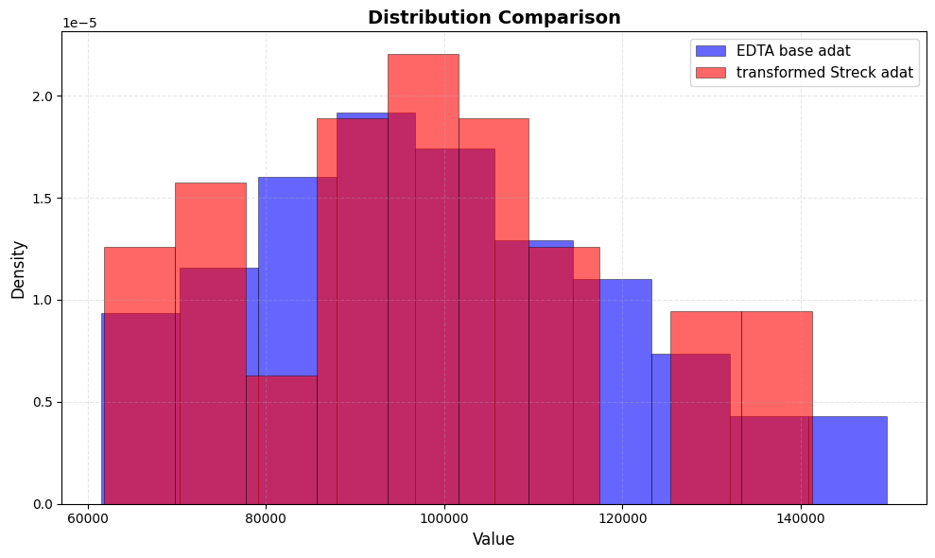

Slide 14
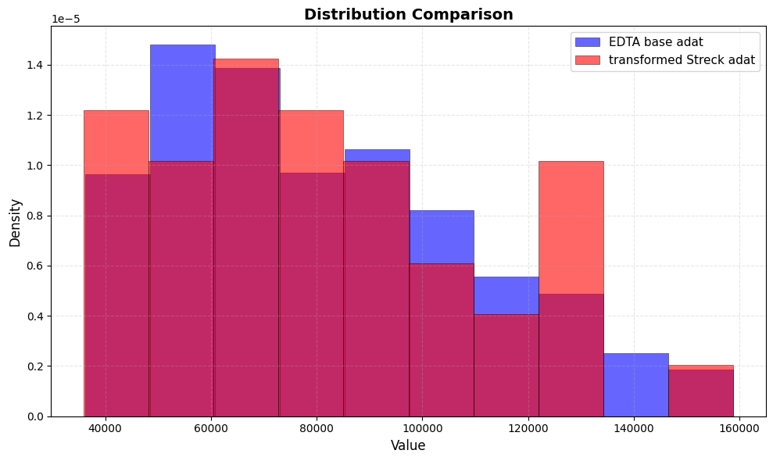

Slide 15
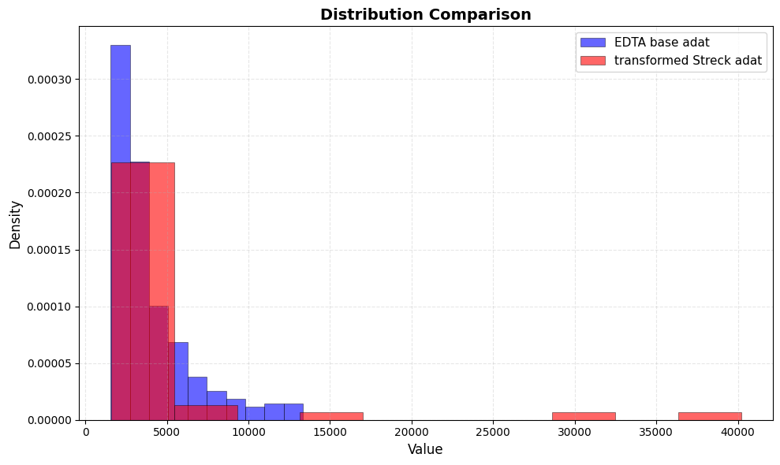

Slide 16
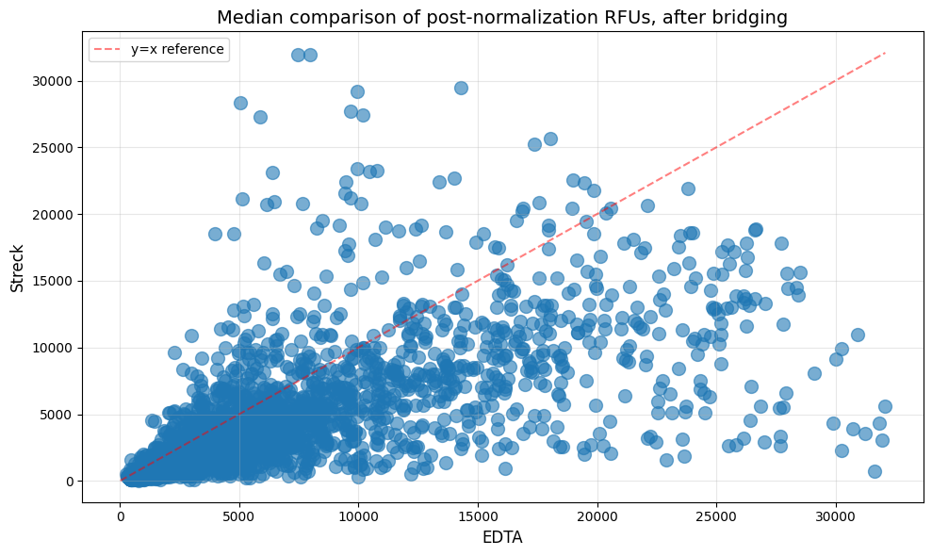
Post-normalization results of pre-hybridization bridging
  Post-normalization assessment

Slide 17
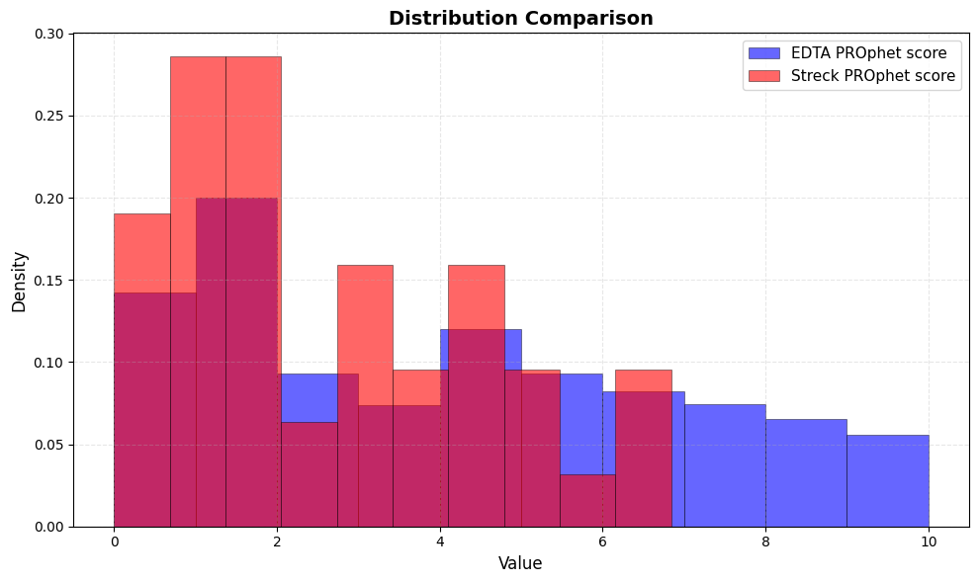

Slide 18
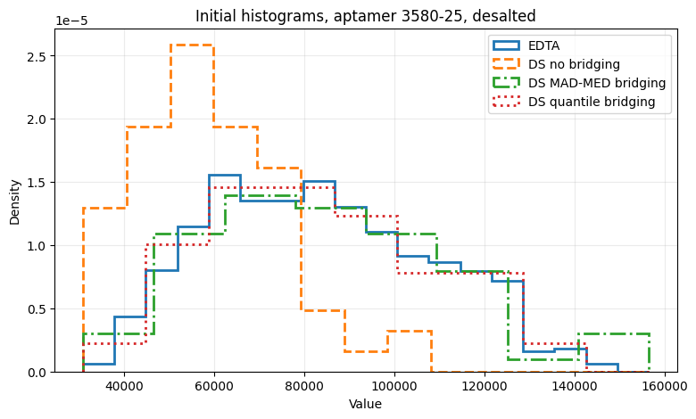
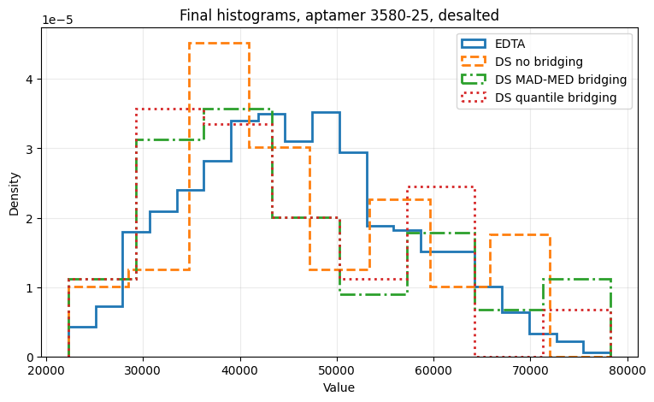
Pre-normalization vs. Post-ANML, DS

Slide 19
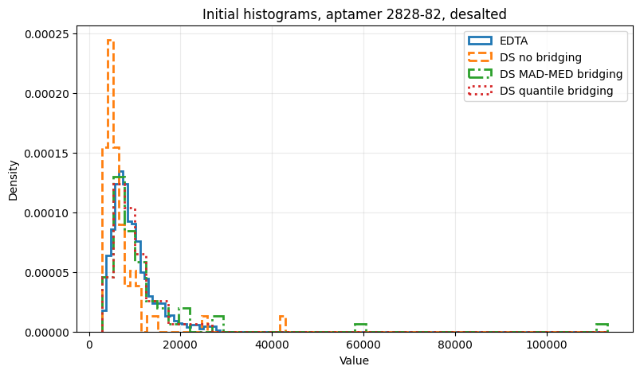
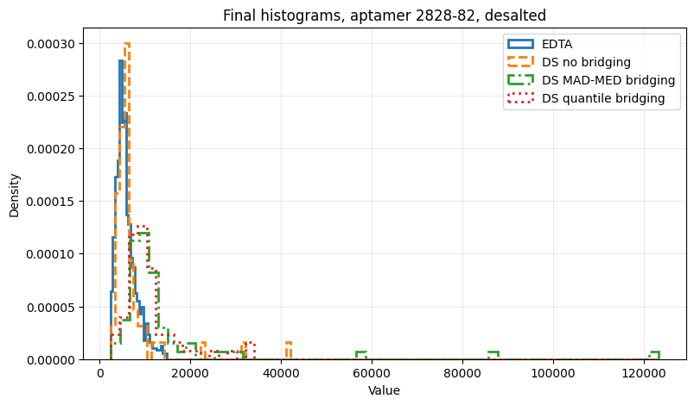
Pre-normalization vs. Post-ANML, DS

Slide 20
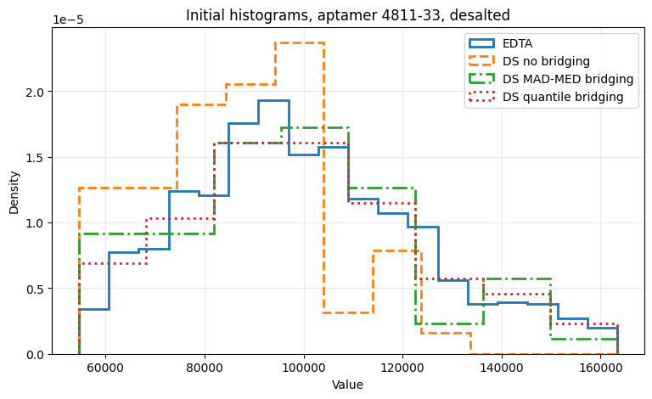
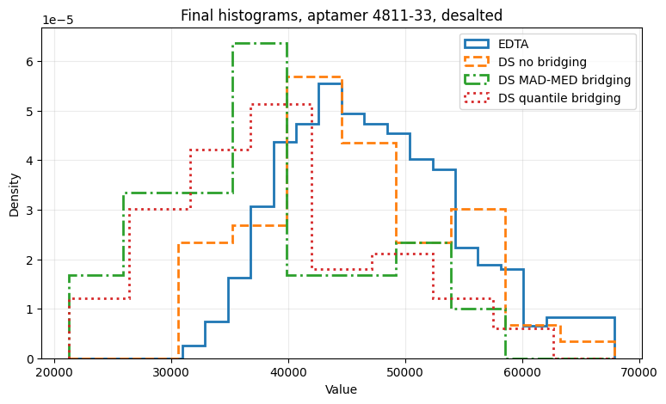
Pre-normalization vs. Post-ANML, DS

Slide 21
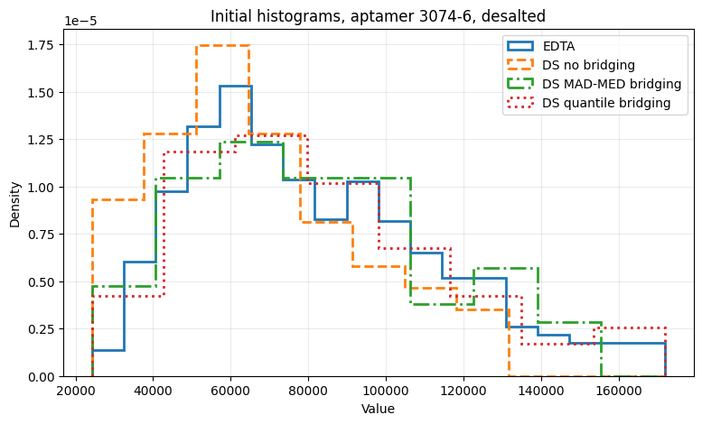
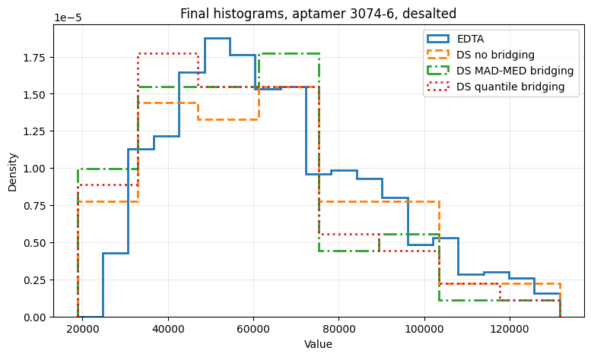
Pre-normalization vs. Post-ANML, DS

Slide 22
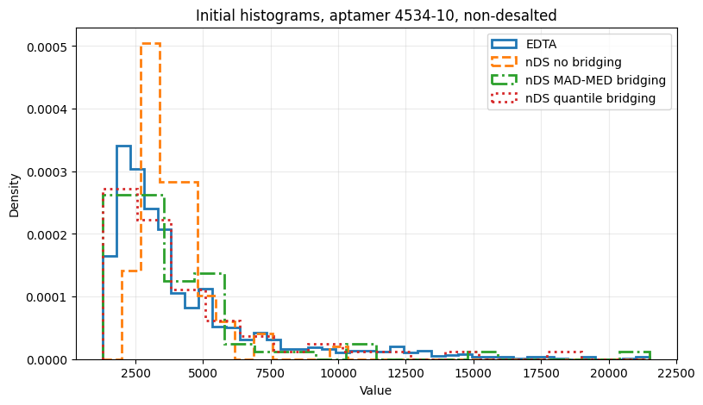
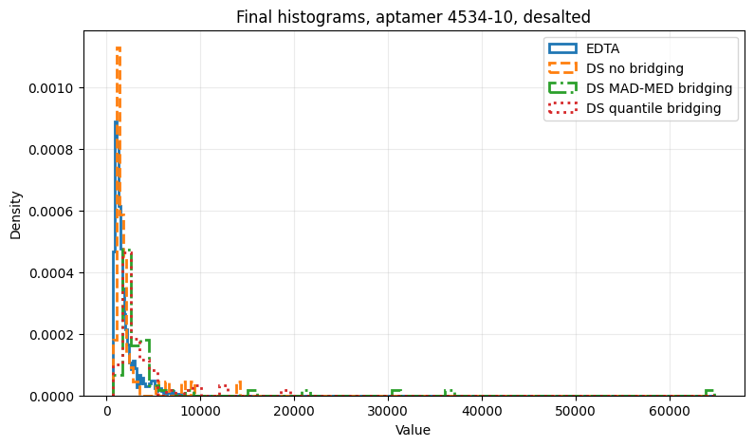
Pre-normalization vs. Post-ANML, DS

Slide 23
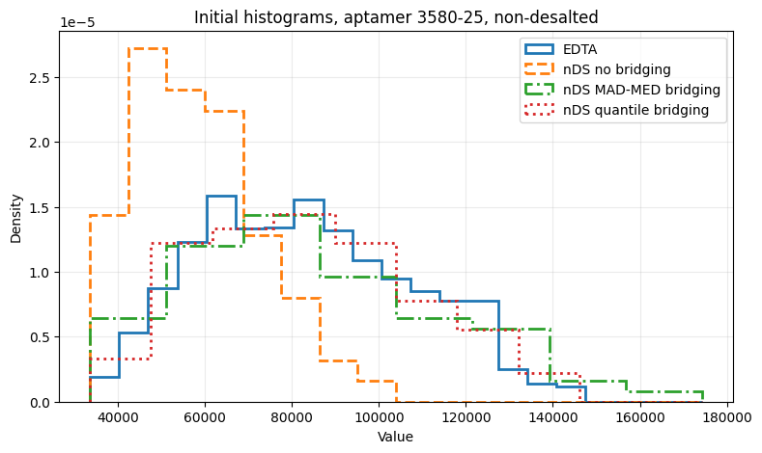
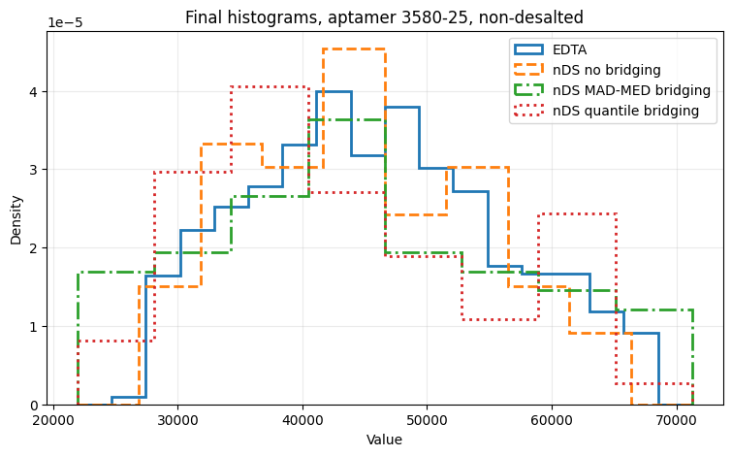
Pre-normalization vs. Post-ANML, nDS

Slide 24
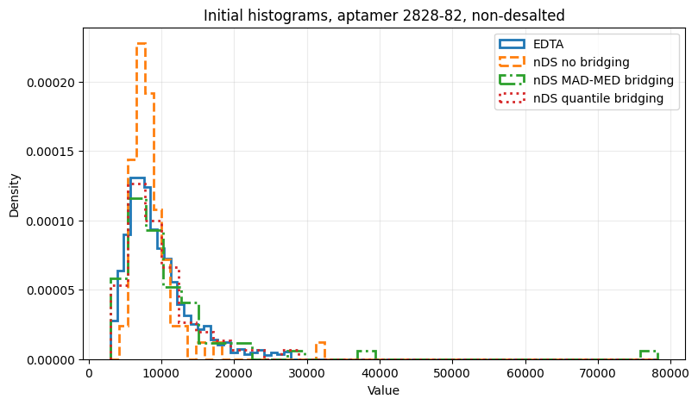
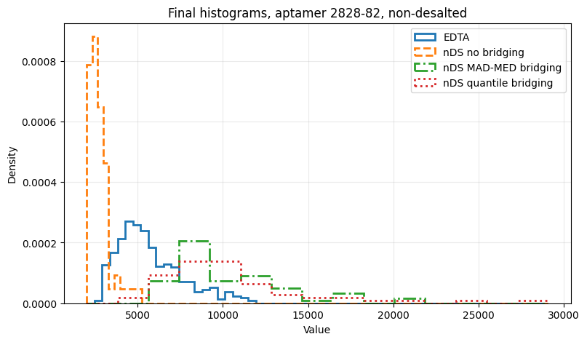
Pre-normalization vs. Post-ANML, nDS

Slide 25
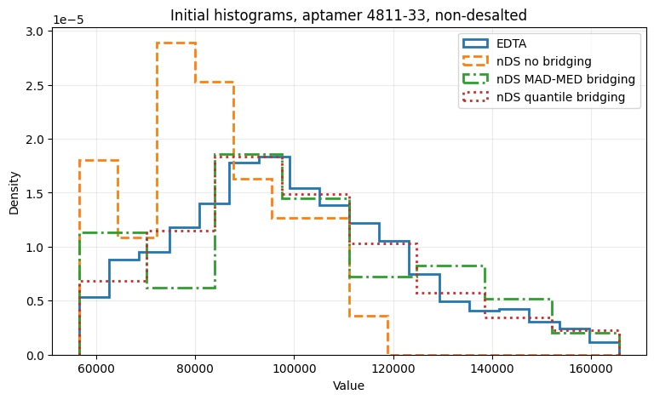
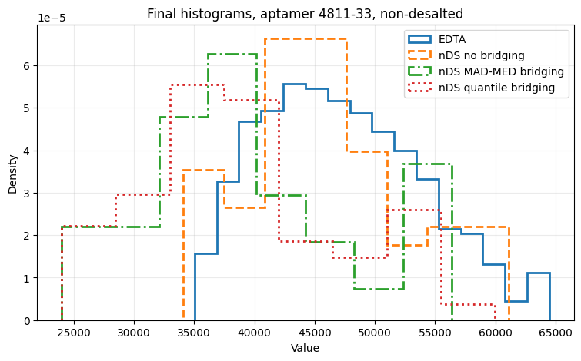
Pre-normalization vs. Post-ANML, nDS

Slide 26
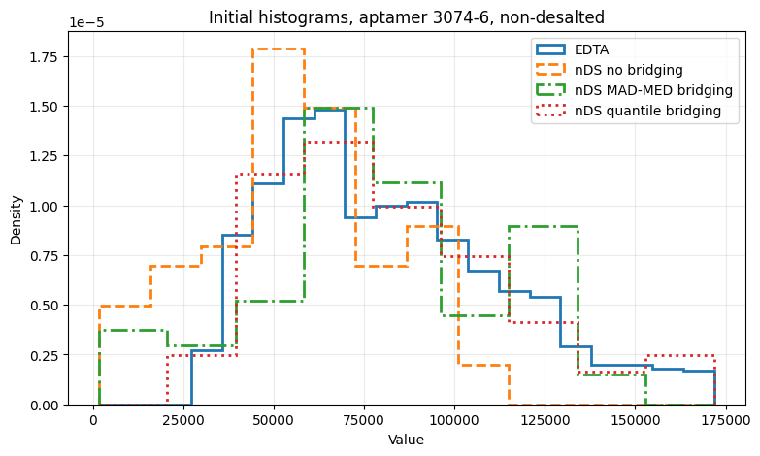
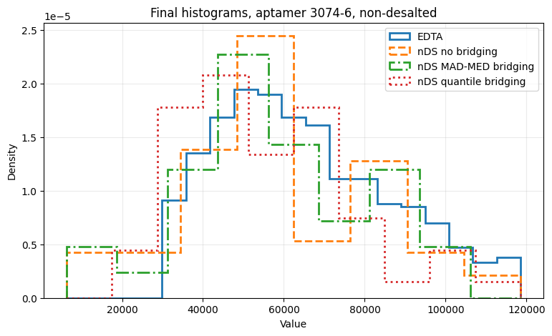
Pre-normalization vs. Post-ANML, nDS

Slide 27
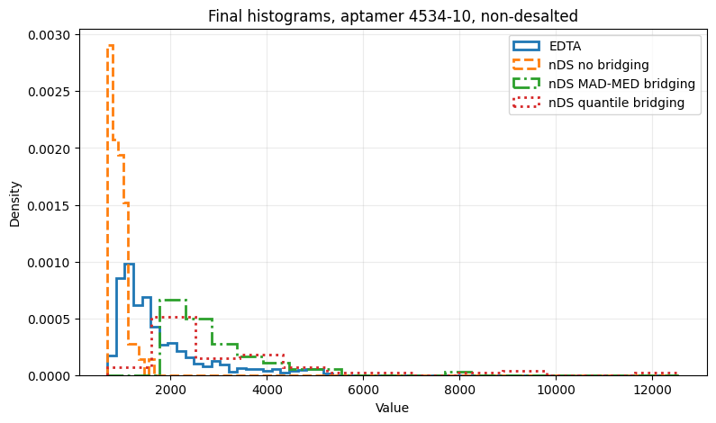
Pre-normalization vs. Post-ANML, nDS

Slide 28
Double Bridging

Slide 29
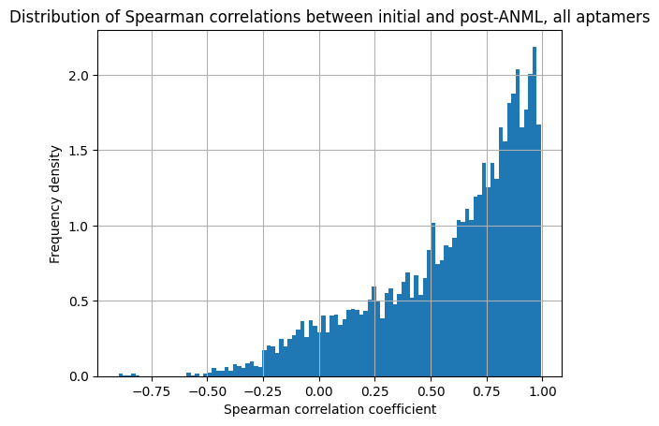
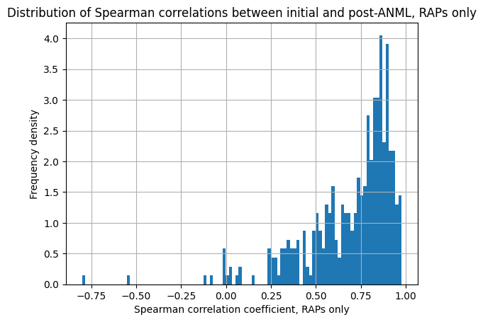
Spearman effects of SL normalization – overall and RAPs

Slide 30
Spearman effects of SL normalization – overall and RAPs

Slide 31
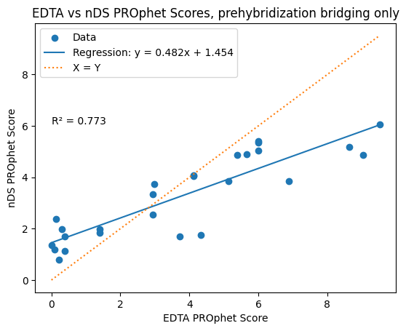
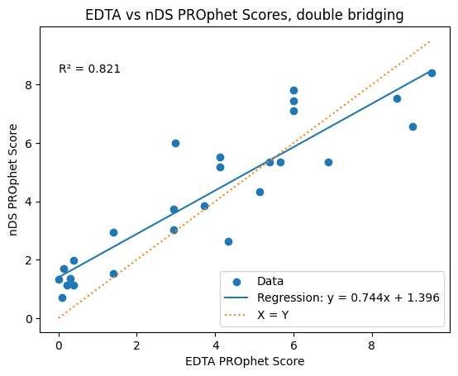
Matched samples - nDs

Slide 32
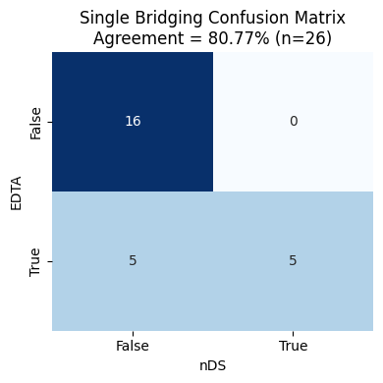
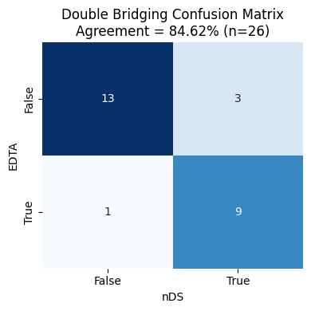
Matched samples - nDs

Slide 33
Results analysis
Pre-hybridization bridging does good job of reducing pre-normalization differences
It DOES NOT reduce post-normalization aptamer differences
It DOES NOT reduce post-normalization PROphet score variability
Likely culprit: Streck bridging of non-desalinated samples with desalinated-based params affects normalization steps.

Slide 34
Next steps
Create NDS-based bridging parameters
Change bridging pipeline to allow for separate bridging of DS/NDS samples
Complete local end-to-end pipeline for creating bridging parameters, employing them to plates, normalizing and assessing results
Once results sufficiently improve deploy new bridging to production

Slide 35
Next steps - continued
Check: With separate NDS-based bridging is linear bridging good enough?
Oncohost-specific ANML normalization?

